Slide 1
CERN Mock-up test results
Long run at ln2
Setting up the Mock-up
Overall conditions of the test
Stress test
Long stay test
Conclusion
Next step
P. Barrillon⁽¹⁾, L. Boistay⁽²⁾, F. Hubaut ⁽¹⁾, P. Pralavorio⁽¹⁾, P. Skensved⁽³⁾, M. Van Uffelen⁽¹⁾, Cryolab⁽²⁾
(1) CPPM, (2) CERN,(3) Queen’s University

Slide 2
Mock-up
Introduction
Determine robustness of calibration system at cold, and during a long period (LN2 then LAr).
 | MU_CShort | MU_CLong | MU_Warm
Purpose | Robustness against ice formation, source blocked, bend, pipe leak |  | Behaviour in bends, DS20k Length
Temp. (K) | LN2 (77) | LN2 (77), LAr (88) | Room (290)
Location | CPPM | CERN | CPPM
Pipe lgth (m) | 4 | 2 | 15 (~DS-20k)
Nb bends | 2 | 1 | 15 (11, 7)
Runs | 09+11/22, 03/23 | 1 month @ June 23 | 03-04/23
Huge thanks to the CERN Cryolab for providing and running the Cryostat, the LN2 and the LAr

Slide 3
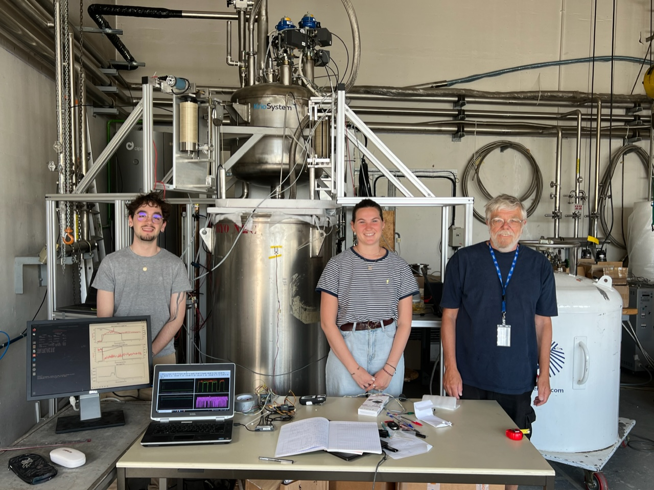
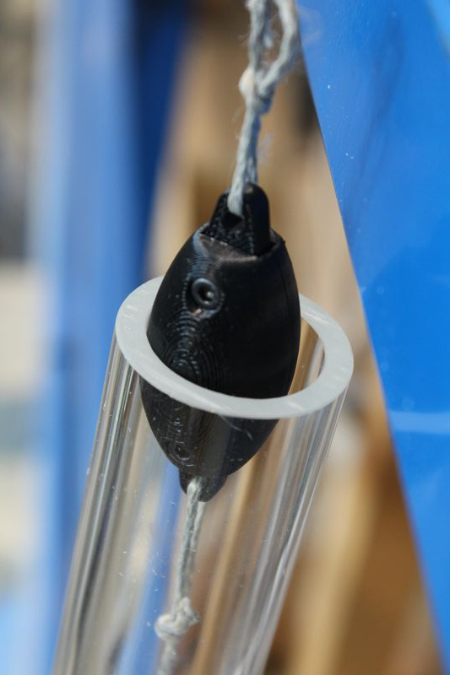
Mock-up
Test’s schedule
LN2
Dewar2
Pseudo–source
L = 5.5cm
φ = 2.5 cm
M= O(100) g
In CERN Cryolab, building 159
30/05-2/06 : Installation
5-9/06 : Settings
9-26/06 : LN2 tests
26/06-03/07 : Warming up Cryo to put LAr
03-10/07 : LAr tests (TBD)
LN2
Dewar1
Cryo

Slide 4
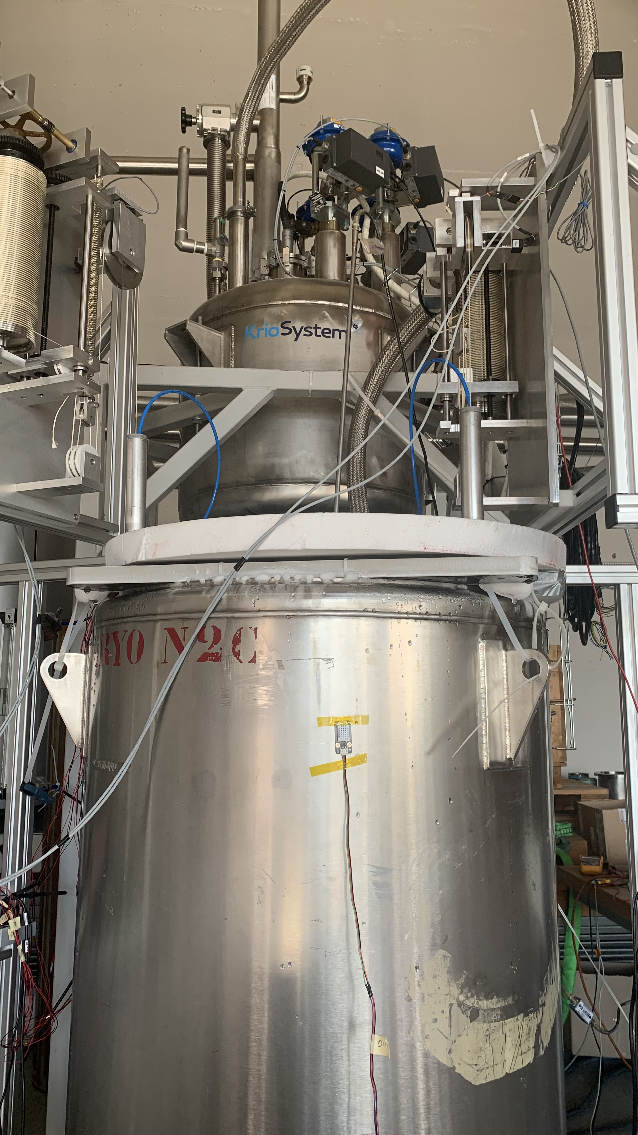
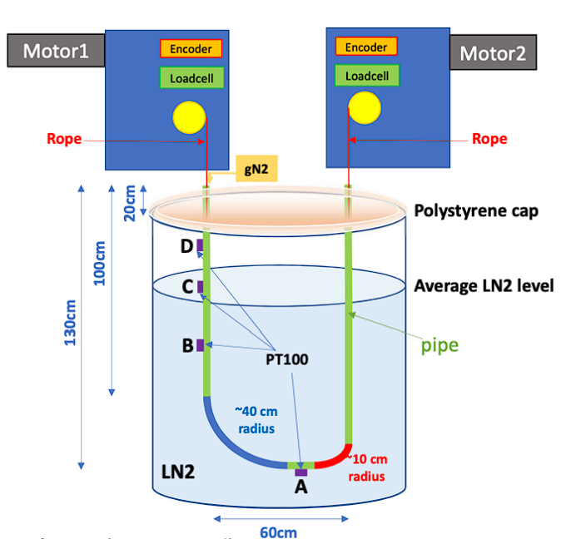
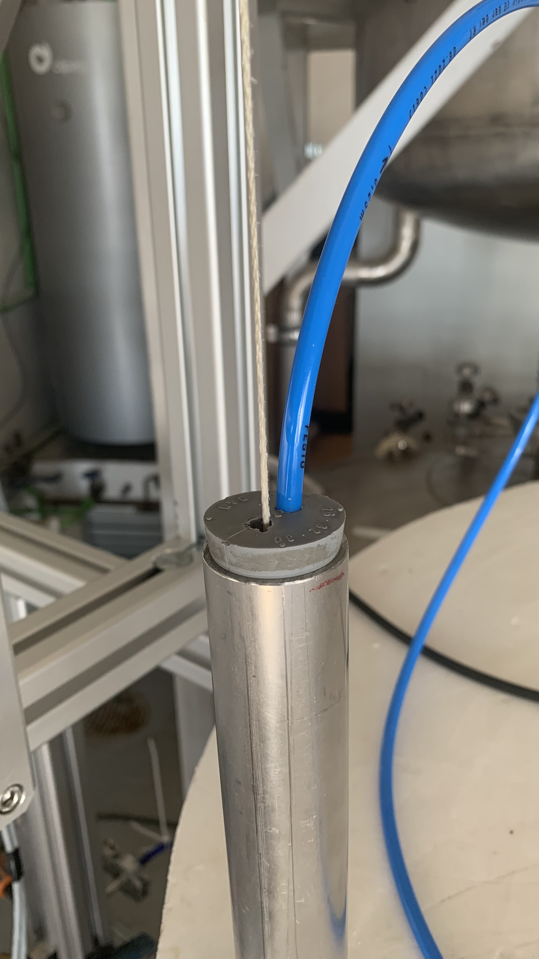
Mock-up
Setup
gN2 flush
DS4
DS2
Rope
LN2
Dewar1
The tube cap is not fully hermetic because of rope and gN2 flushing
The cryostat is not fully adiabatic ➔ Need constant refill with LN2
4 PT100 probes (A, B, C, D)
1.3 meter of useful tube (from A to D)

Slide 5
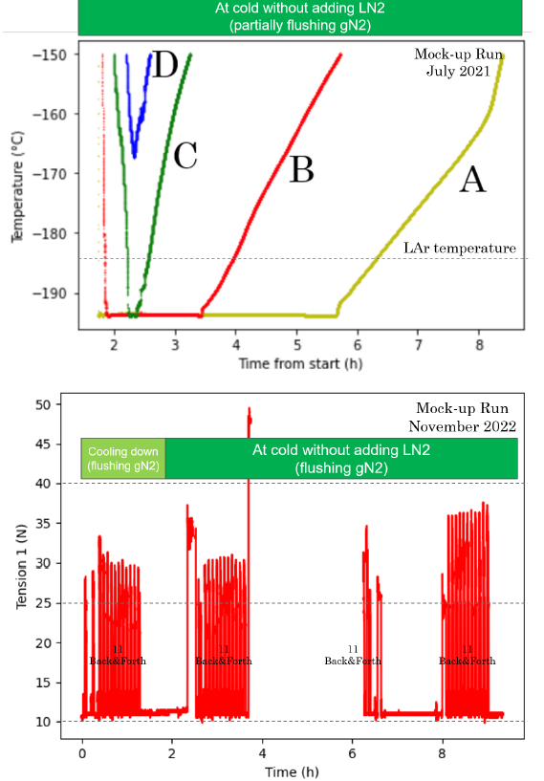
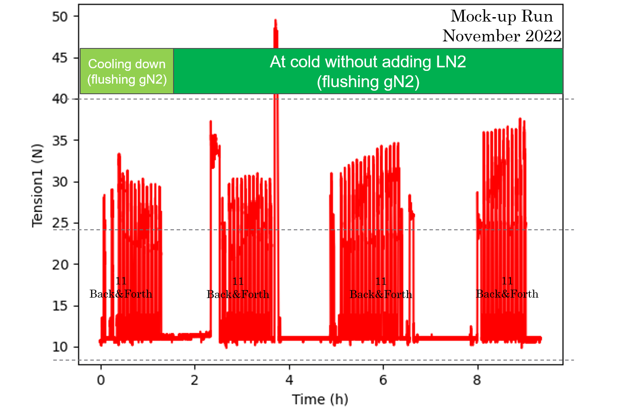
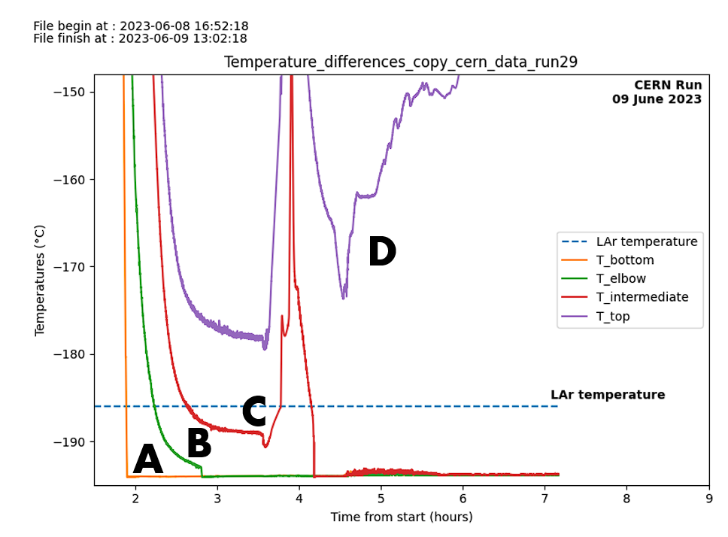
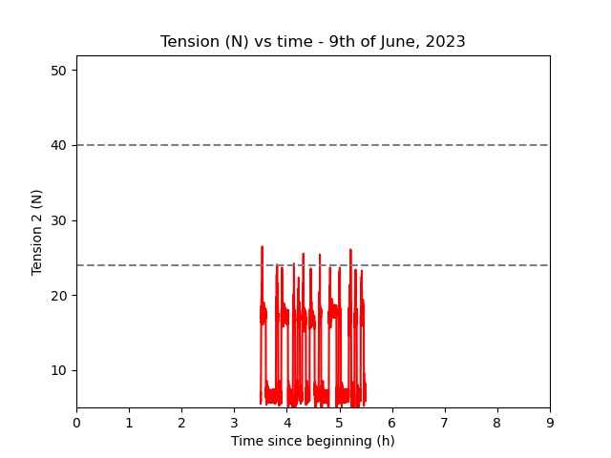
Mock-up
Comparison with CPPM MOCK-UP (first 8 hours)
RUN | Temperature of A, B, C, D | Tension | Conclusion
CPPM short run, Poorly isolated cryostat (0.16 m³) |  |  | Left gN2 flushing at 60L/h T_{A} <= T_{LAr} for only 5h after filling Tension 12-40N
CERN long run, Vacuum isolated cryostat (0.4 m³) |  |  | Left gN2 flushing at 60L/h T_{A}, T_{B}, T_{C} always below T_{LAr} once filled Tension 5-25N
Dewar1
Dewar2
Motorized Systems work at CERN.

Slide 6
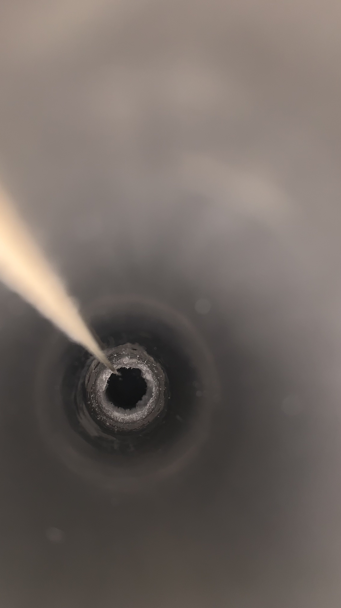
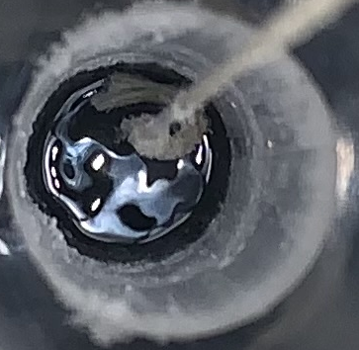
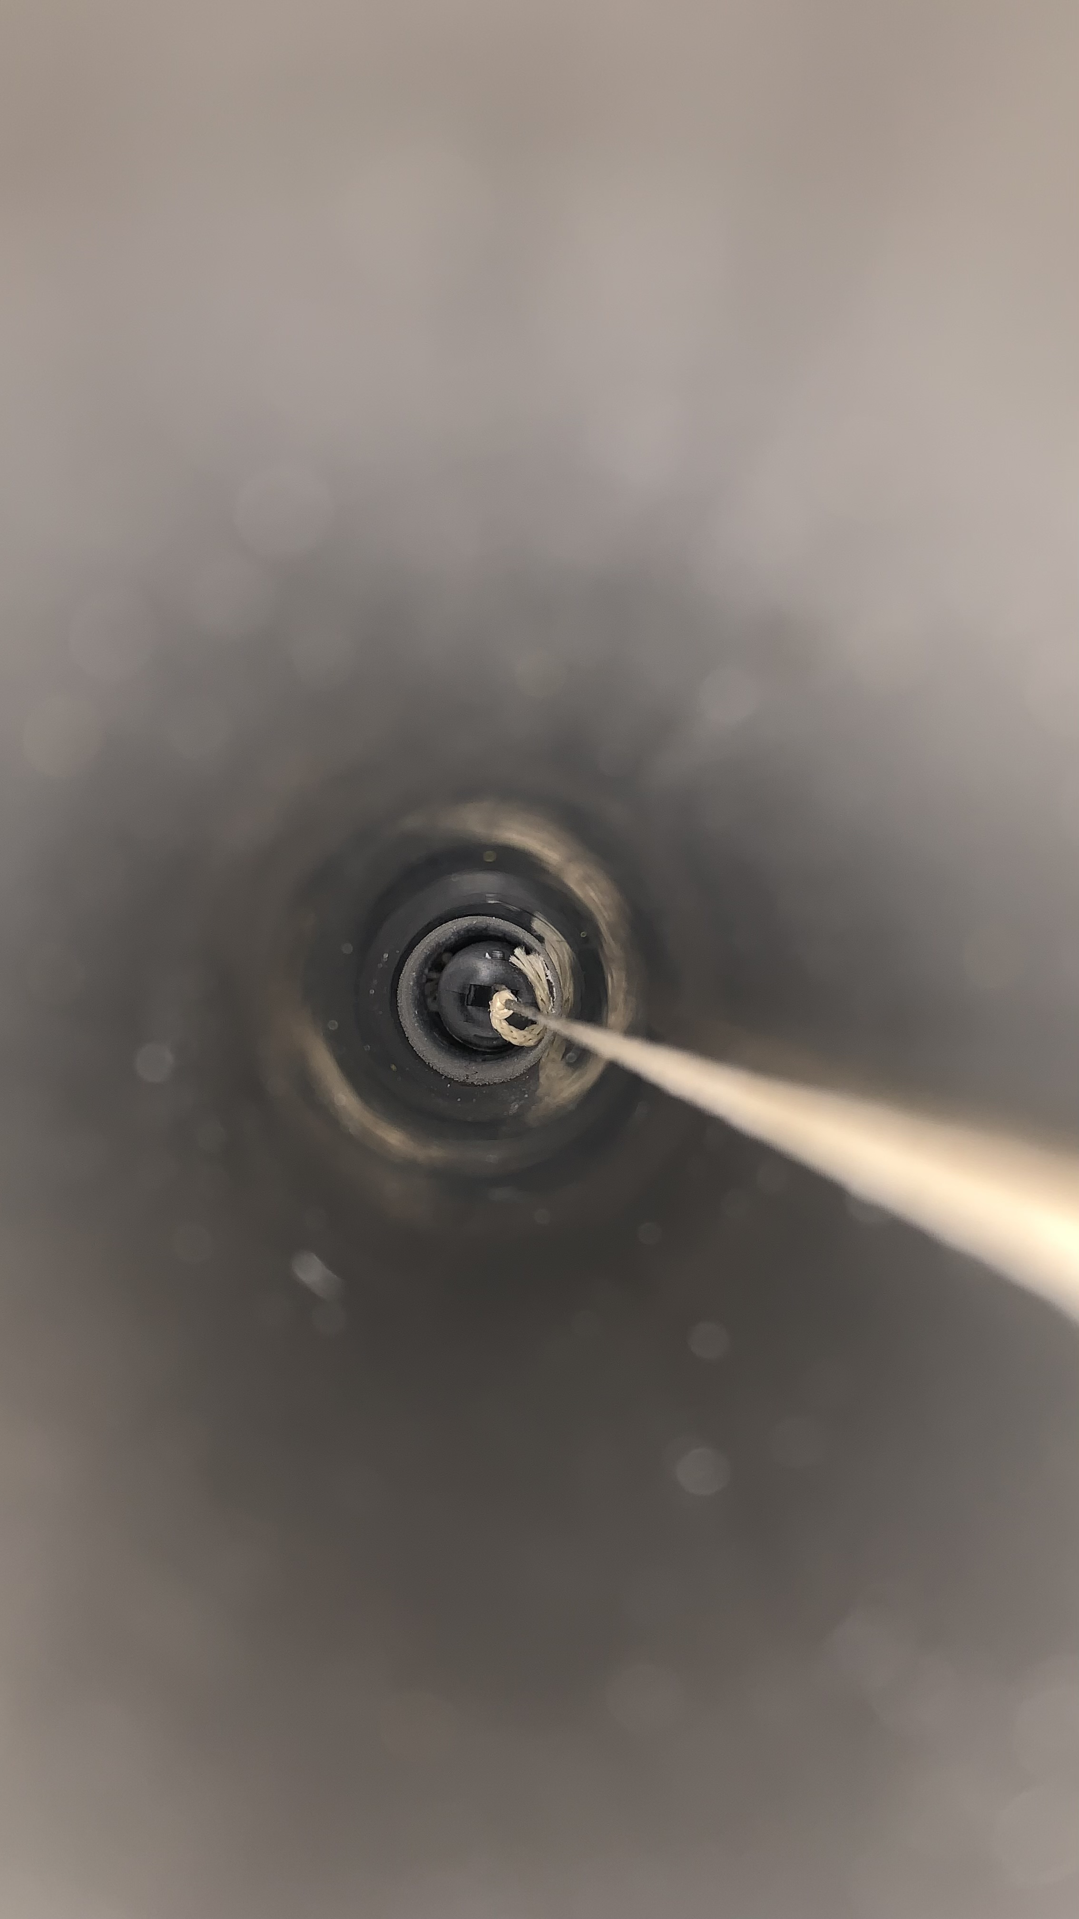
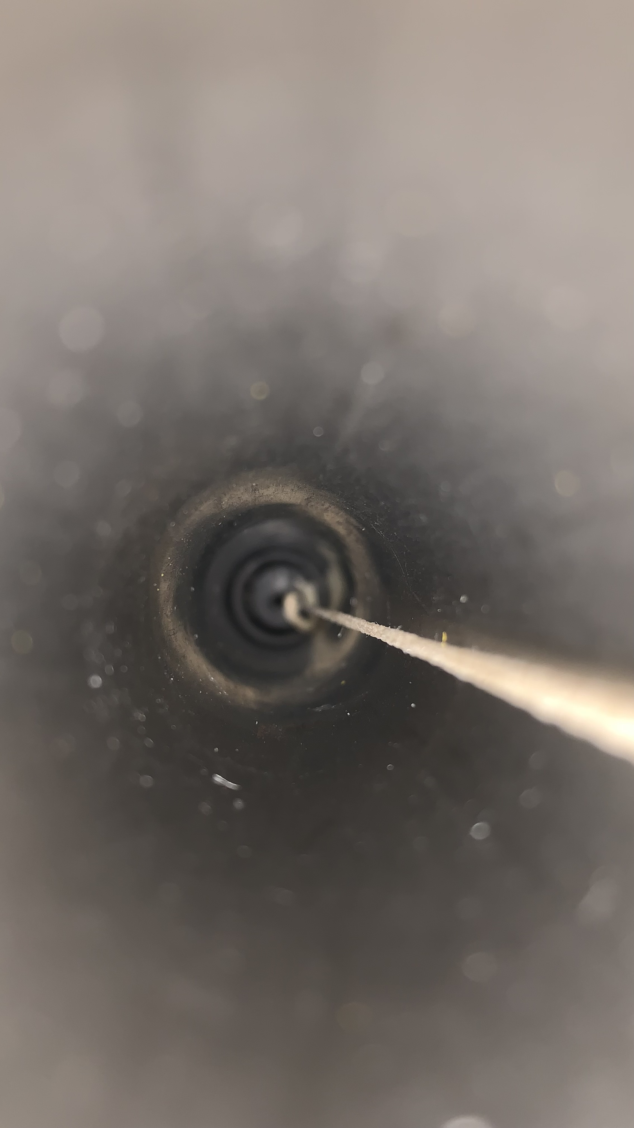
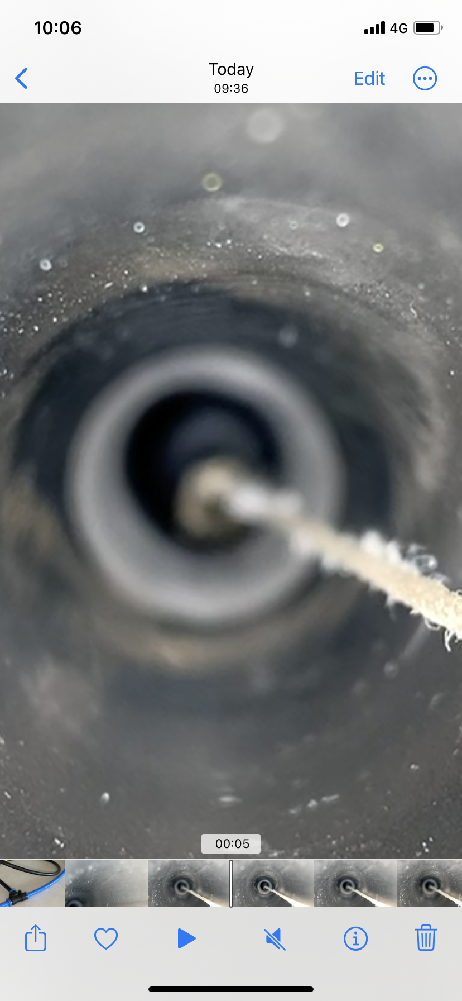
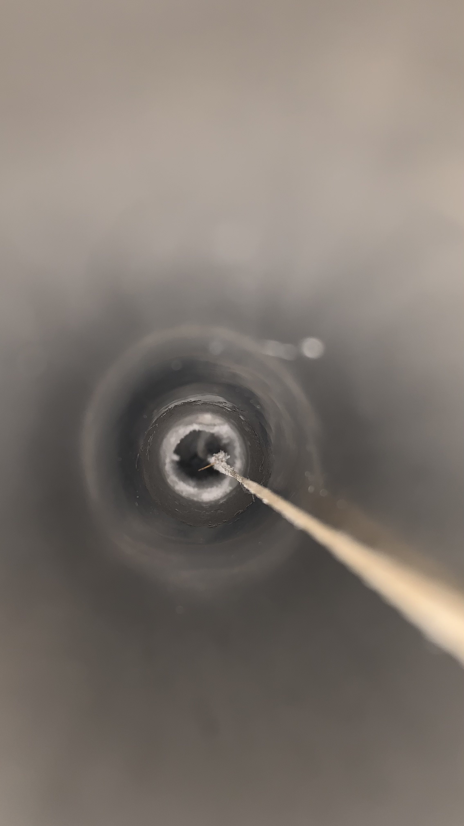
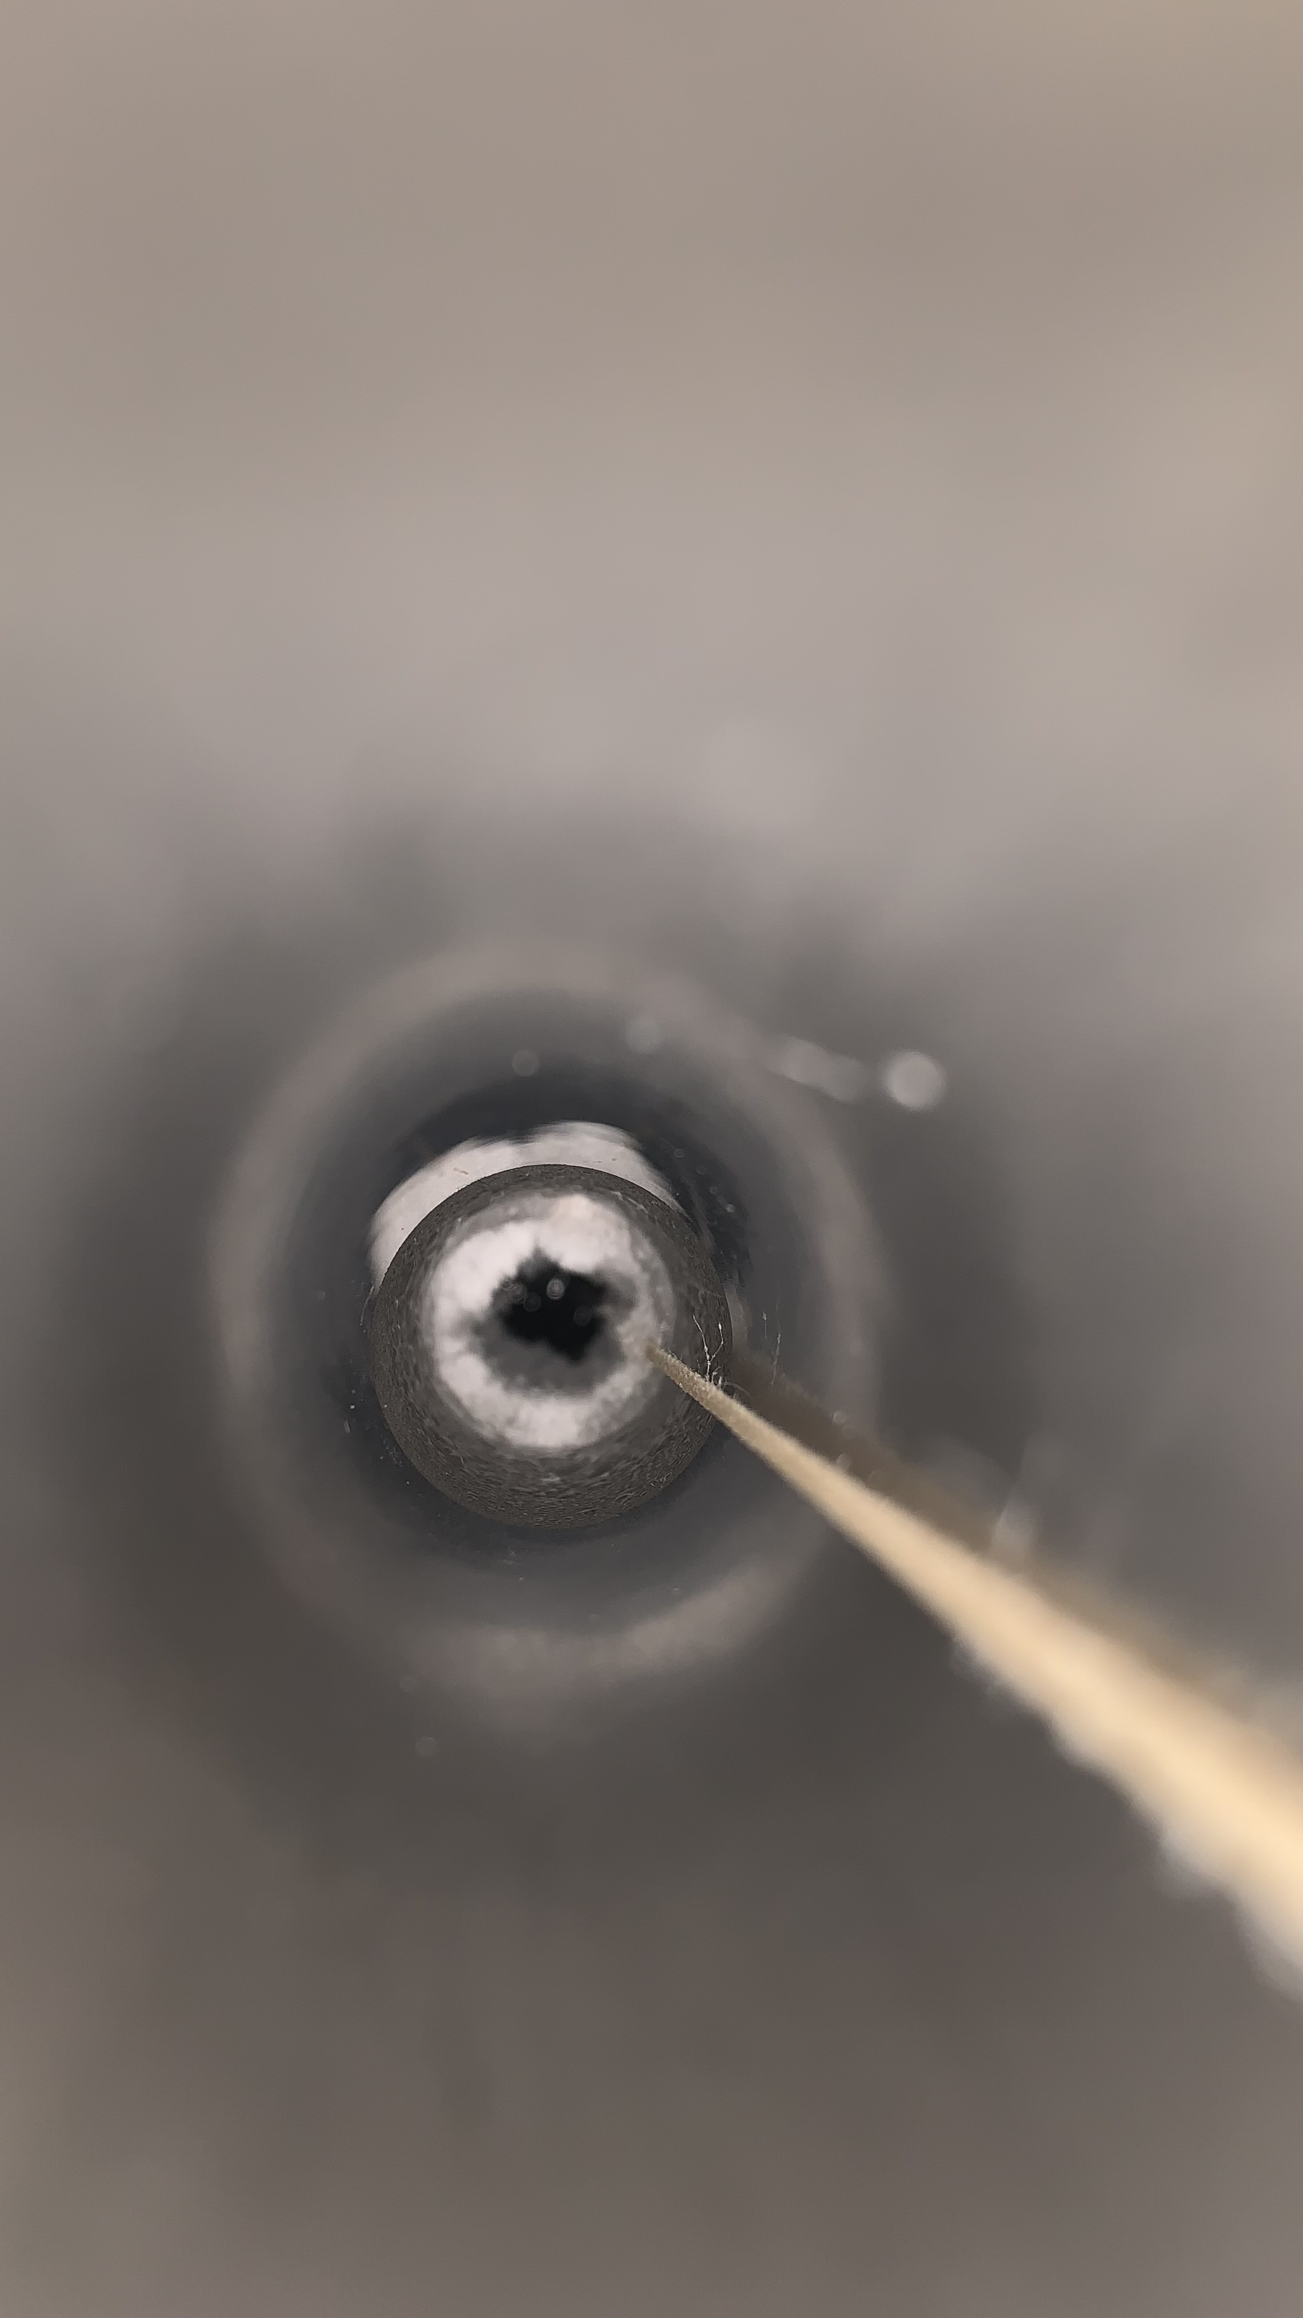
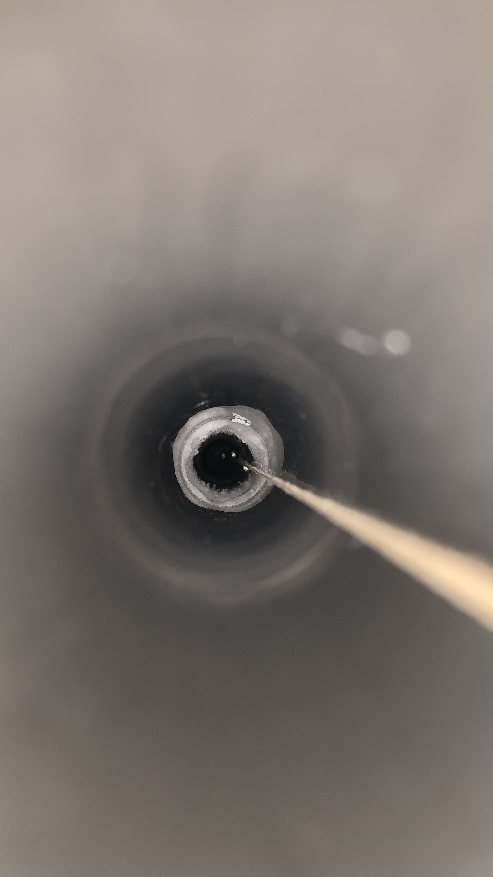
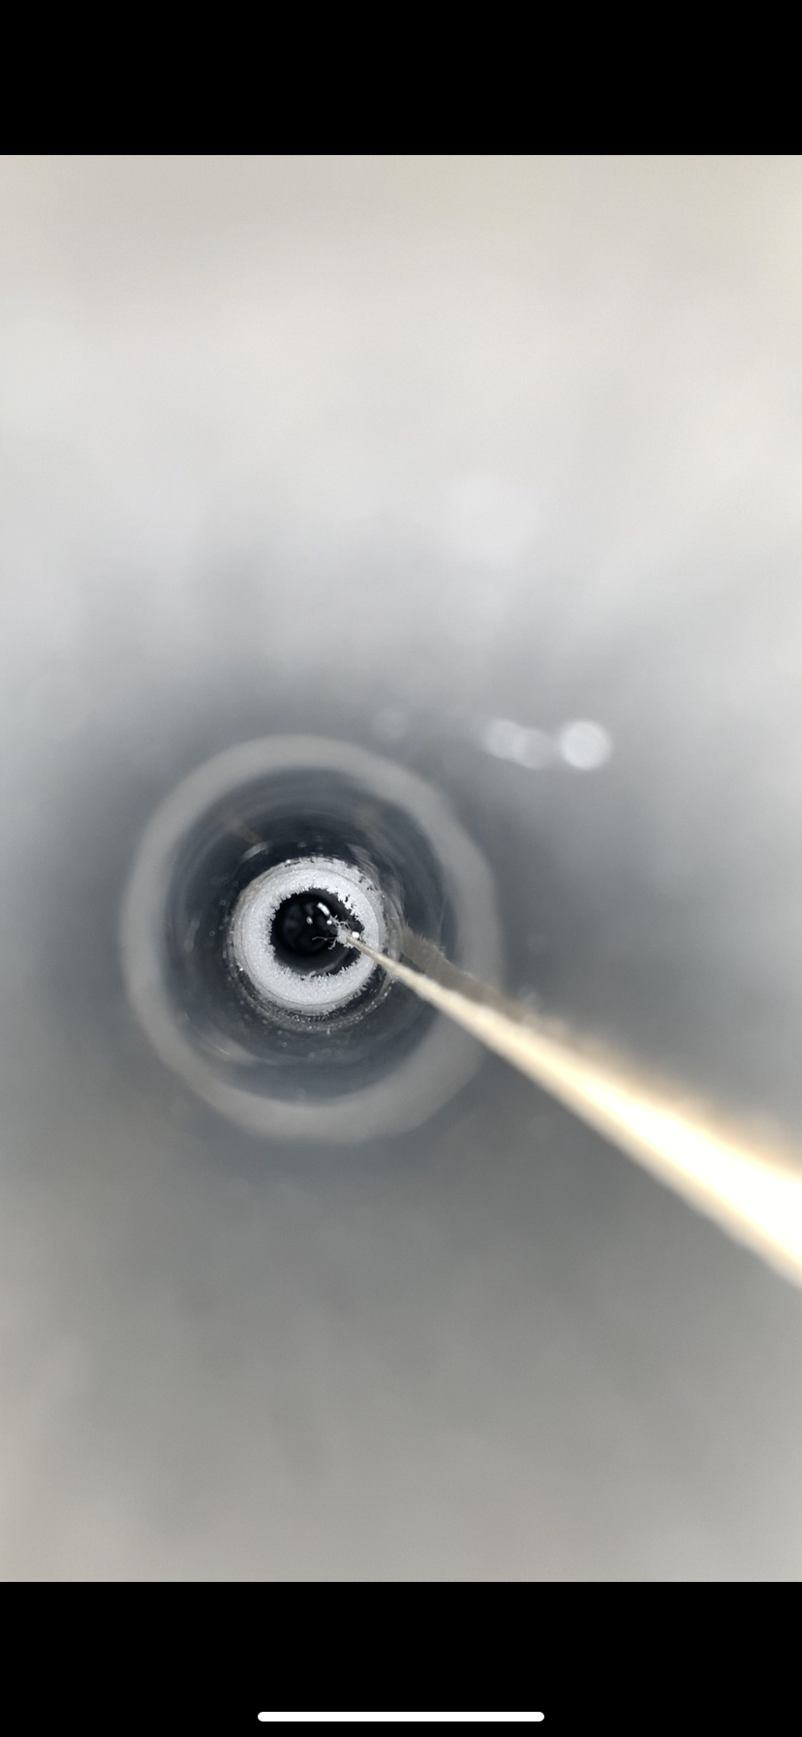
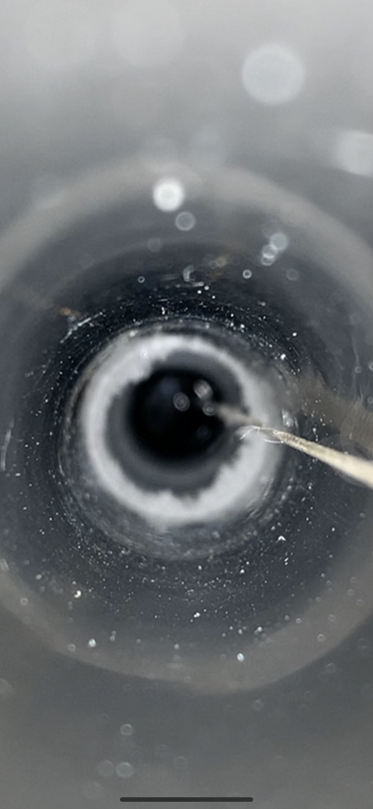
Overall conditions of the test
Ice formation mitigation
Date | 09/06 | 10/06 | 12/06 | 13/06 | 26/06
Left Side (DS4)
Right Side (DS2)
1- Ice formation on both sides (09/06) ➔ Flush hot gN2 on left at 250L/h (4x nominal)
➔ Left side ice turns into frost
2- LN2 inside (-50cm) tube prevent gN2 to reach right side ➔ T pipe to flush left and right (250L/h)
➔ Ice on right side turn into frost
LN2
Frost
Frost
Ice
(T)
(T)
Pictures are cropped to be visible so do not pay attention on sizes, more on shapes.
The rope on the corner of tube to take the picture, in center usually
Ice turns into frost after 1 day of
large gN2 flush on both sides ➔ Stable conditions for test

Slide 7
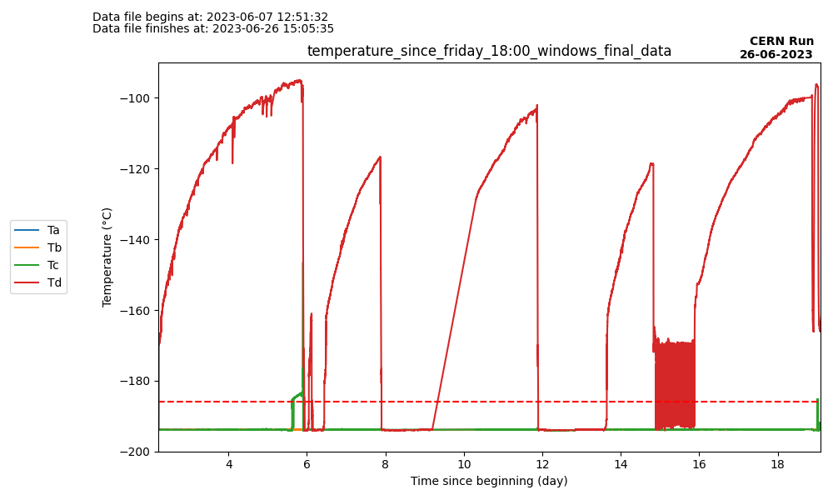
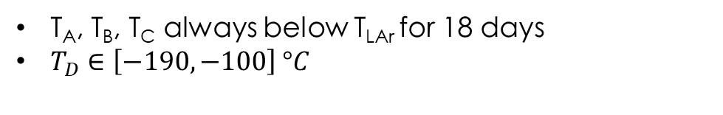
Test conditions (18 days)
Temperature of PT100 and tank filling
Prepa
Stable
End of cooling
300
D
250
Tank refills
Slope
0.5%/h
200
gN2 flow (L/h)
150
100
A,B,C
50
0
Filling process is automatic (no auto-filling on the weekends and on Wednesday)
Flushing at 120L/h (2x60 with T)
T_{A}, T_{B}, T_{C} always below T_{LAr} for 18 days
$T_{D}∈\left[−190, −100\right] °C$

Slide 8
Stress test with LN2
Program
DS4
DS2
The goal is to check robustness of the Mock-up
Back and forth (b&f) from the cold garage to PT100 A (2x 1,3m) with a ~1min stop at the edges (~1 cm/s)
35 b&f/day (~3h) for 8 days In DS20K, 8 sources so 4b&f and 20m tube → 280 b&f ➔ 70x DS20k → ~740m ➔ 5x DS20k
Cold Garage

Slide 9
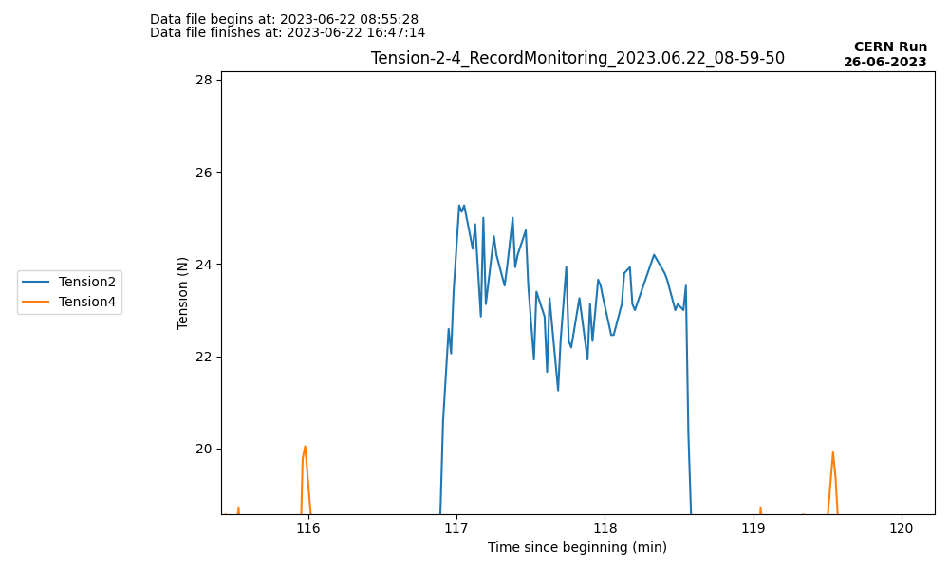
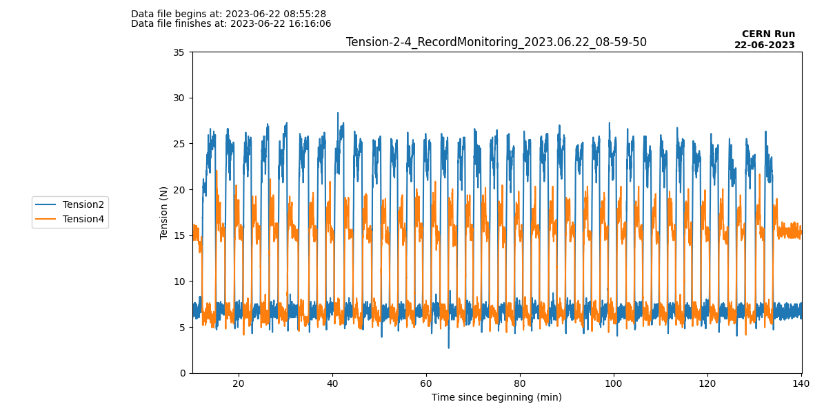
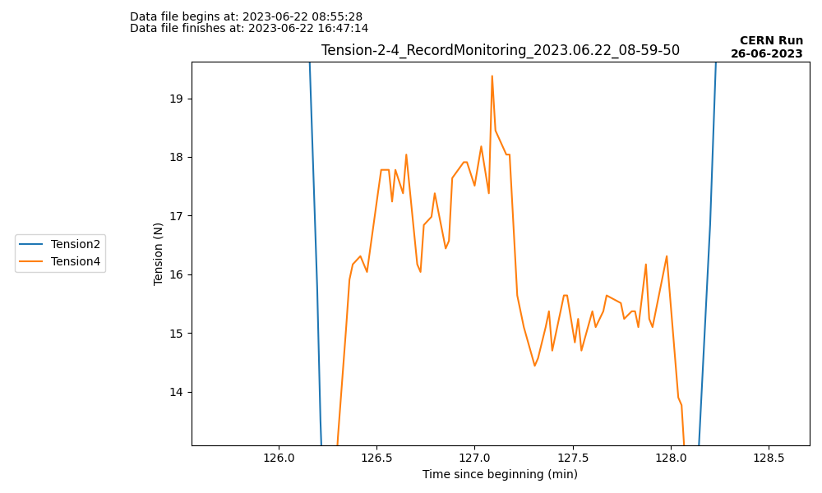
Stress test with LN2
TYPICAL RUN
2 typical tension depending puller motor
Tension ~23N
90s
Tension ~16N
Typical tension for DS2
6N
Following motor’s tension
DS4
Cold garage
DS2
DS2 tension around 24N, no visible impact of tube geometry
DS4 tension lower, and reflects the tube geometry
D
In tube LN2 level
C
B
A
Typical tension for DS4

Slide 10
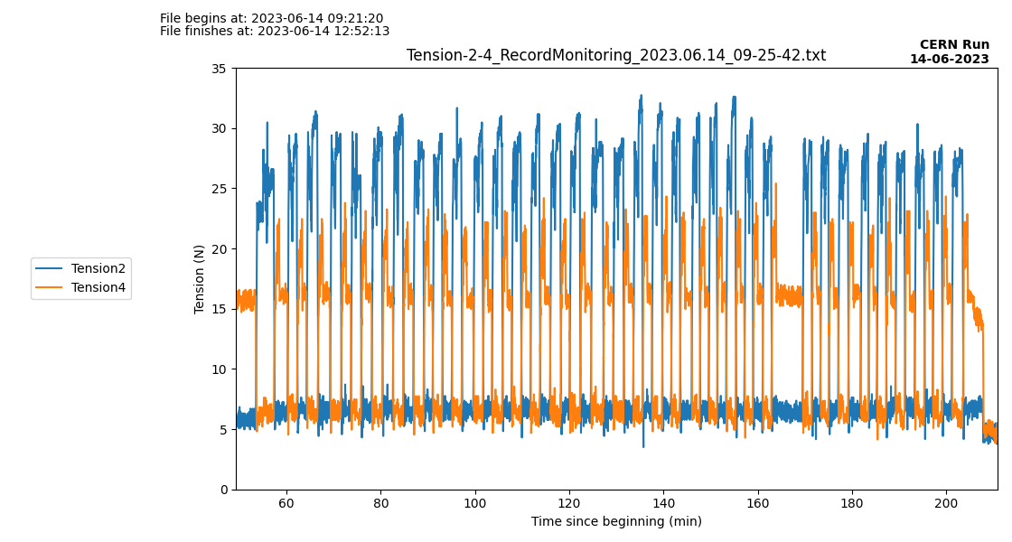
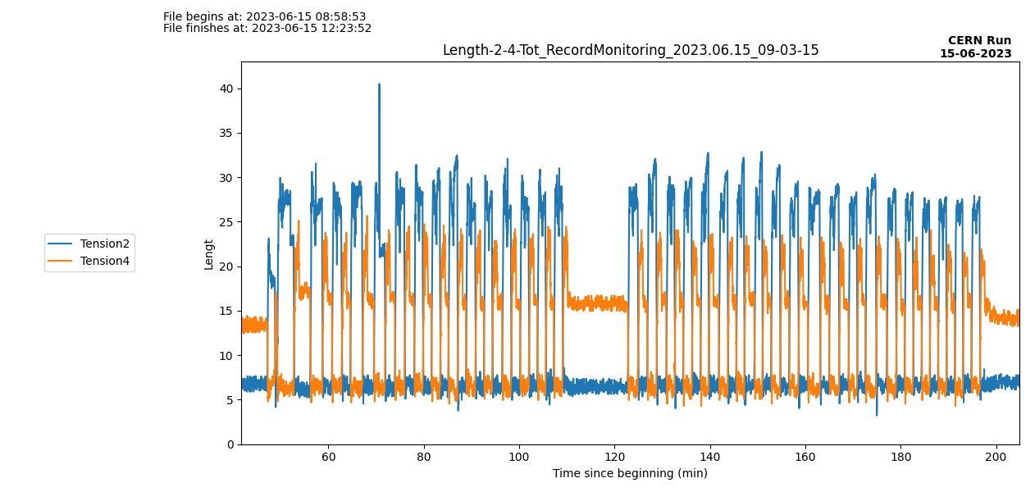
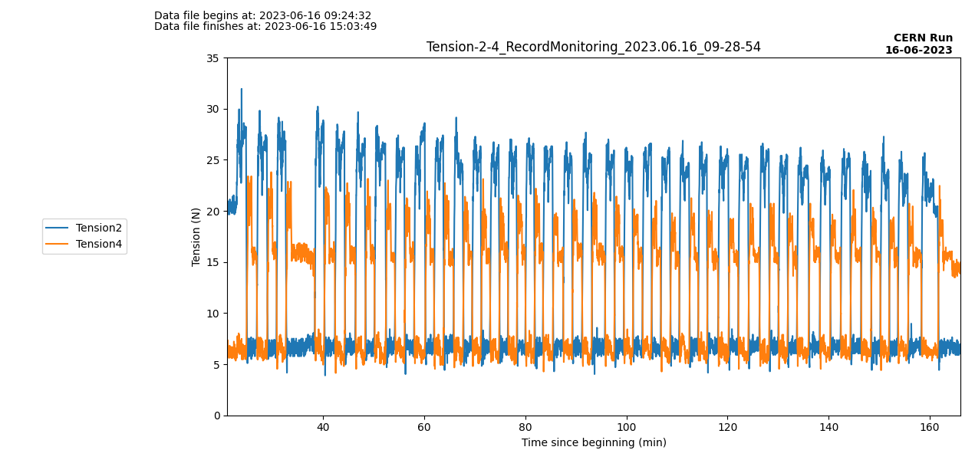
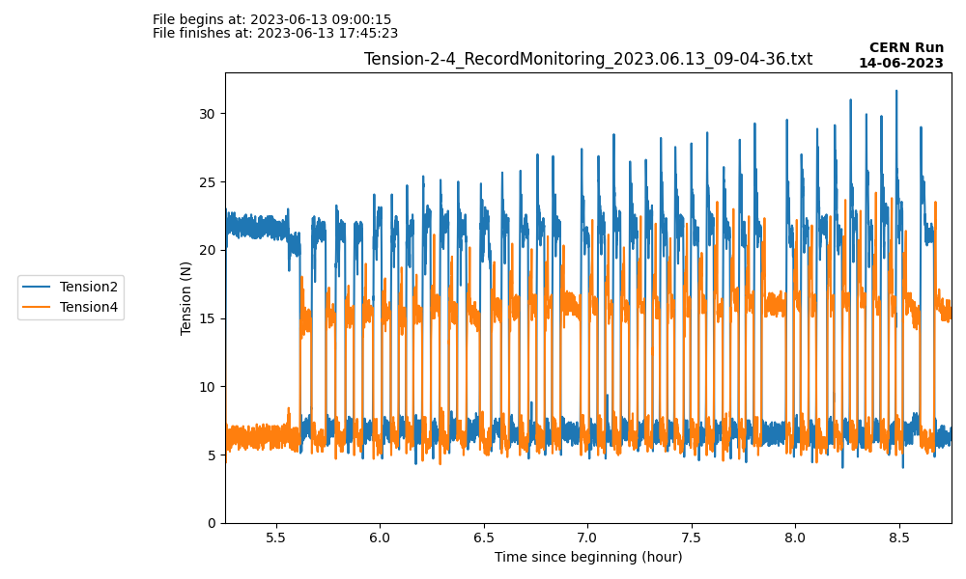
Stress test with LN2
Results (First week)
10min break during the test
40N spike
23,5°C/40%
23,5°C/40%
24,5°C/43%
25°C/40%
Tension ~23N
Tension ~16N
6N
Following motor’s tension
13/06
14/06
15/06
16/06
DS2 tension : two days at 25-30N at worst

Slide 11
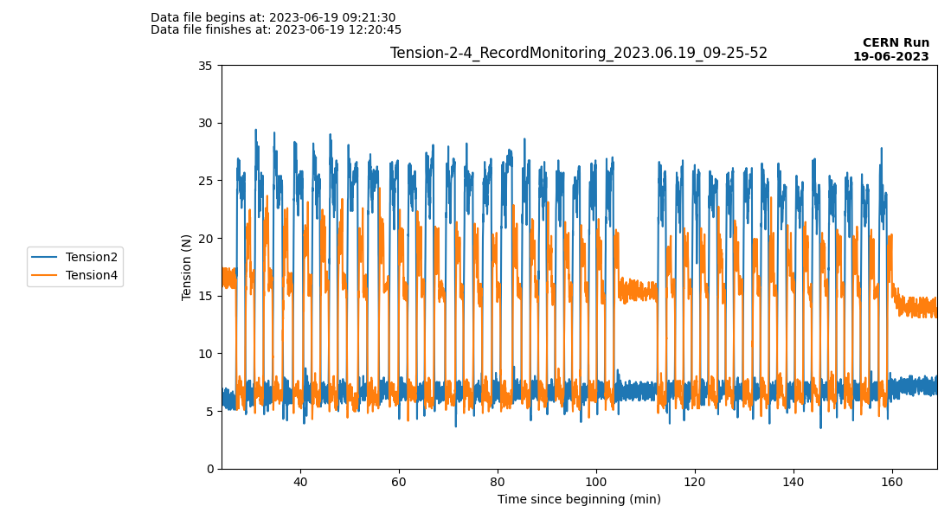
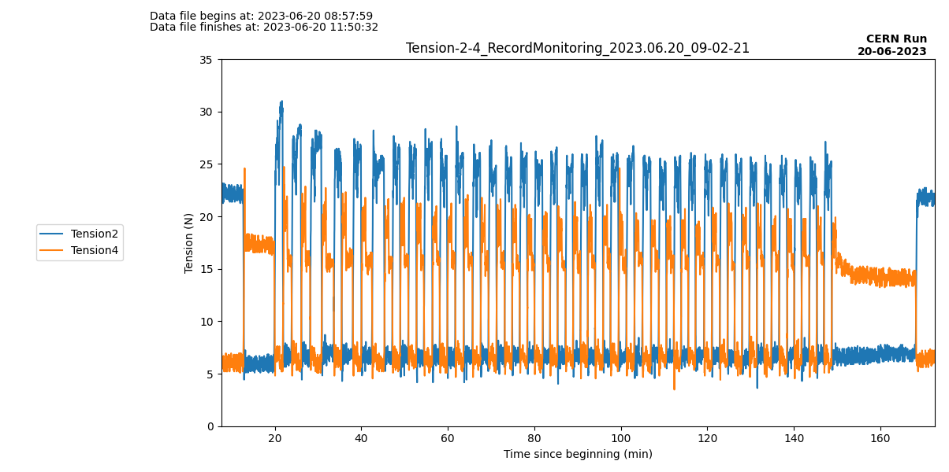
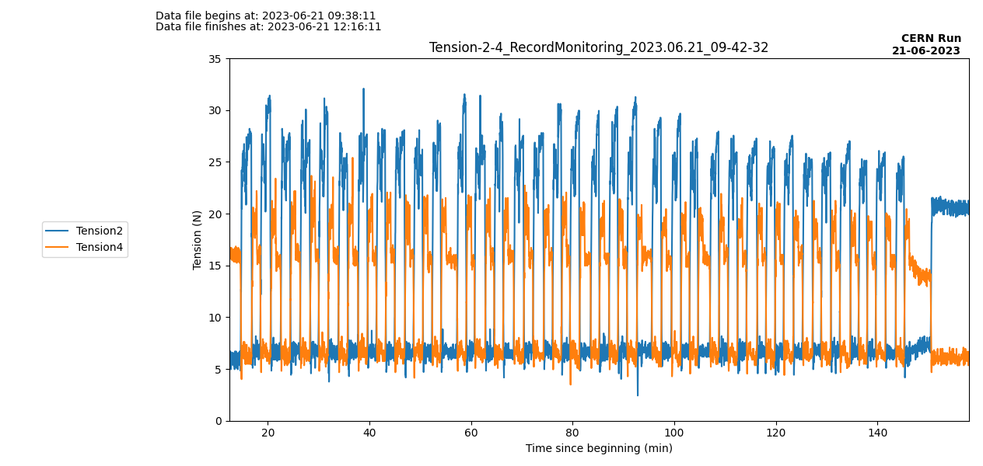
Stress test with LN2
Results (Second week)
10min break during the test
24,5°C/47%
25°C/54%
26°C/53%
24°C/60%
Tension ~23N
Tension ~16N
6N
Following motor’s tension
19/06
20/06
21/06
22/06
The tension is stable

Slide 12
Long stay test with LN2
Program for the test
The goal is to check how the motors react when the source is left for a long time at a PT100 step.
We left the source at different spots for different periods of time (1min, 10min, 30min, 1h, 2h, a night, a weekend)
Source | ⁵⁷Co | ¹³³Ba | ²²Na | ¹³⁷Cs | ⁶⁰Co | AmBe | AmC | AmLi
Energy (keV) | 122 | 356 | 511 | 662 | 1173 | [0.2, 12] | [2, 7] | [0, 2]
Activity (side) (kBq) | 18 | 1,9 | 0,36 | 2,2 | 0,36 | 0,14 | 0,15 | -
Activity (bottom) (kBq) | 100 | 5 | 0,67 | 4,6 | 0,6 | 0,18 | 0,18 | -
Duration of calibration (h) | 3,84 | 18,72 | 23,52 | 36 | 74,4 | 200 | 200 | -
Time on each spot | 12’ | 1h50’ | 2h20 | 3h45’ | 8h | 22h | 22h | -

Slide 13
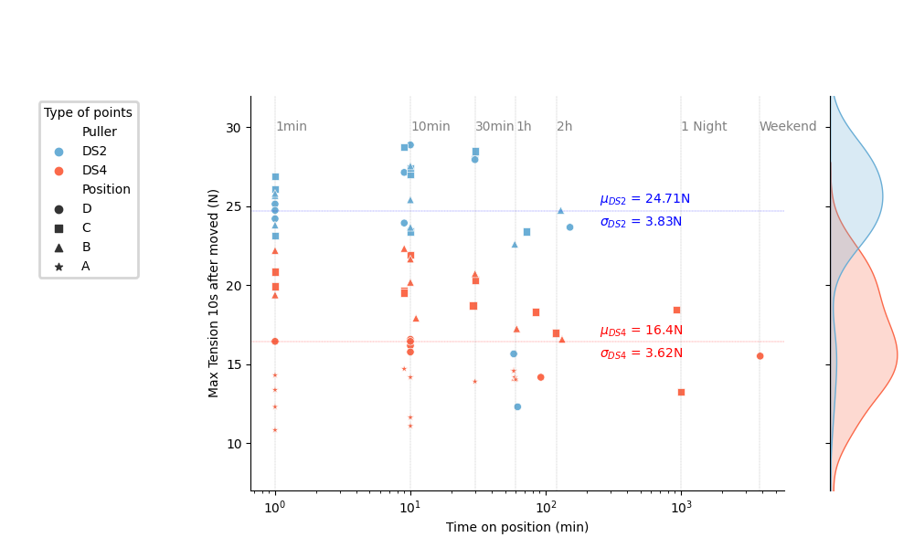
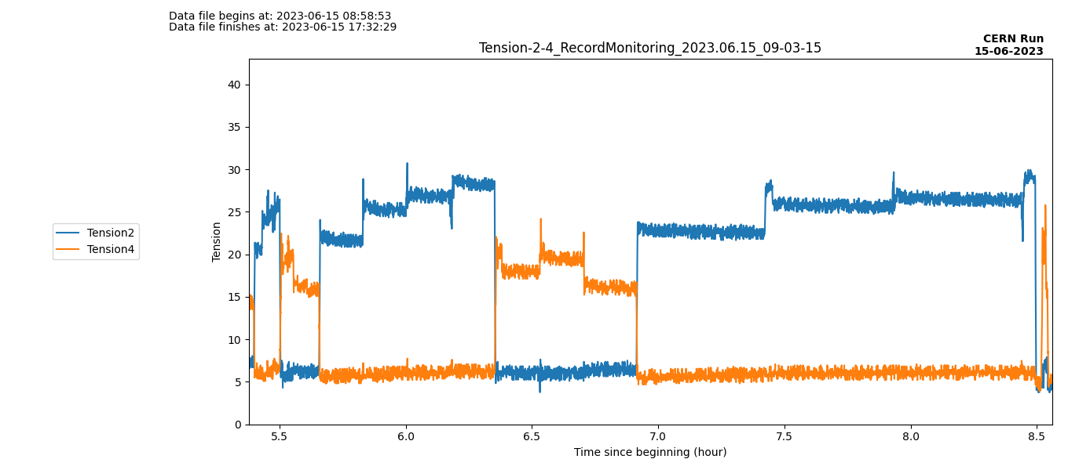
Long stay test with LN2
Tension after stop
1min
10min
30min
C
D
B
A
B
C
A
Tension plot during one test
When the source is moved from its staying position, extract maximal tension 10s after the start of the move

Slide 14
Long stay test with LN2
Tension after stop
Need to be checked

Slide 15
Long stay test with LN2
Tension after stop
Tension is not related to the duration of the stay at the same position

Slide 16
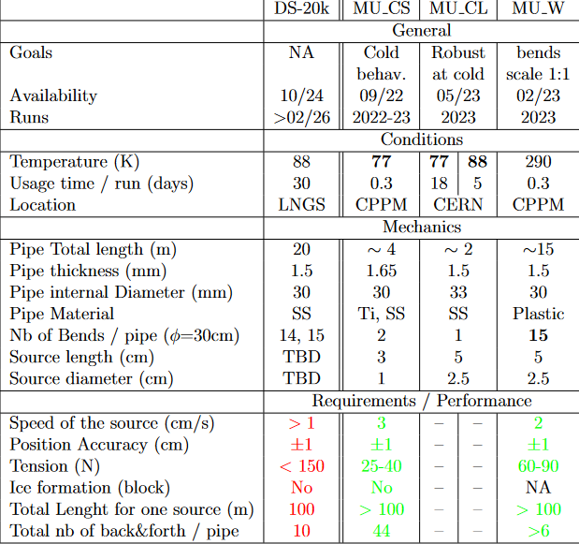
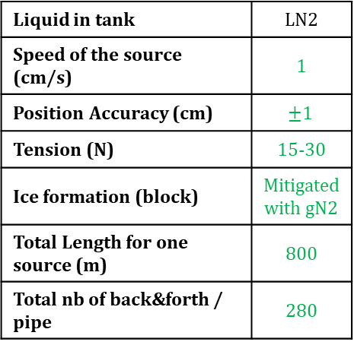
Conclusion
LN2 Mock-up test
Run at CERN at LN2 for 18 days (1,3m of useful tube)
Liquid in the tube 50cm from top → T pipe
Ice formation mitigated using gN2 → Frost
Average tension 15-30N during stress test
No impact on tension when stopping (from 1min to 2 days)
Liquid in tank | LN2
Speed of the source (cm/s) | 1
Position Accuracy (cm) | $$±1$$
Tension (N) | 15-30
Ice formation (block) | Mitigated with gN2
Total Length for one source (m) | 800
Total nb of back&forth / pipe | 280
Robust behavior of calib system at LN2 temperature for 2 weeks

Slide 17
Next test :
LAr for 5 days
Warming up the cryostat for 7 days : from LN2 temperature to above LAr.
We expect to start 3rd of July :
No liquid in tube → gN2 60L/h
Redo stress and calib tests
Liquid in tank | LAr
Speed of the source (cm/s) | ?
Position Accuracy (cm) | ?
Tension (N) | ?
Ice formation (block) | ?
Total Length for one source (m) | ?
Total nb of back&forth / pipe | ?

